Slide 1
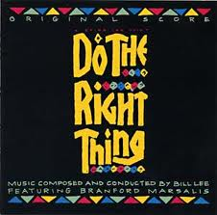
Do The Right Thing
Why everyone should refactor their code

Slide 2

What we are going to do
We are going to learn what refactoring is
We are going to learn why we should always do it
We are going to learn how to refactor using Visual Studio
We are going to learn how to refactor using RedGate
We are going to learn about ways to design your SQL that resemble refactoring

Slide 3
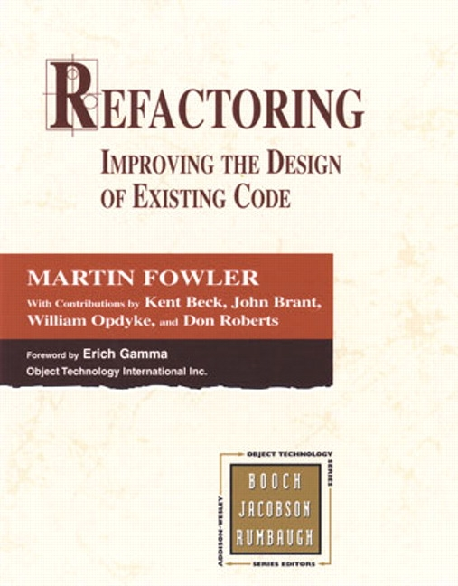
What is Refactoring?
Definition
Code refactoring is the process of changing a computer program's source code without modifying its external functional behavior in order to improve some of the nonfunctional attributes of the software.
Martin Fowler-Refactoring
Change code to explain WHAT you are doing, never tell HOW you are doing it
Design Patterns and Code Smells are end result

Slide 4
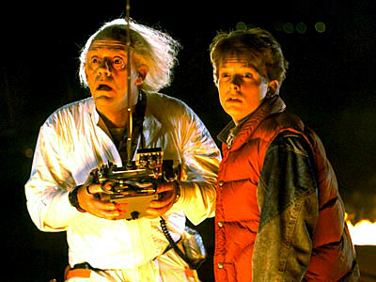

Back To The Future
Programmers vs. Developers
When are you going to see this code again?
Bugs
Upgrading
Tell your future self what you were doing

Slide 5
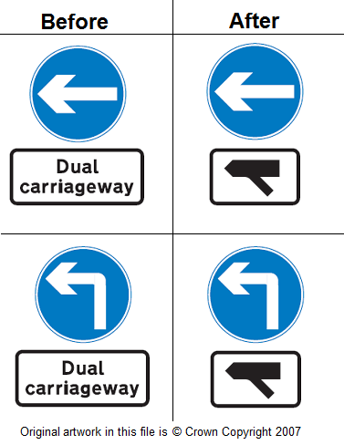
Symbolic equivalence
Humans are NOT very good at this
Just because two different versions of the code do the same thing doesn’t mean they are equal

Slide 6

2 Tests-Watson Selection Test
Test one (Abstract Reasoning)
There are 4 index cards on the table and you are asked to verify a theory on what data is on the cards. The theory is “If there is a vowel on one side, there must be an even number on the other side.” (You see the 4 cards with M 4 E 7 on the one side)
Which two cards must be turned over to determine if the rule is true?
M 4 E 7
Notes:
Shermer-The Mind of the market:etc.
http://books.google.com/books?id=PKjfEOGNZWAC&printsec=frontcover&dq=compassionate+apes&source=bl&ots=uLSP0sKp57&sig=Xrvhi7jS_YhDet64e16r1GiDII8&hl=en&ei=D8r3TLxFi6CxA6qc4MgC&sa=X&oi=book_result&ct=result&resnum=4&ved=0CC8Q6AEwAw#v=snippet&q=drink&f=false

Slide 7


Result one
Most people get check other side of M but also decide to flip over the 4 card.
Real answer is 7 card. 20% get this correct.
Notes:
Shermer-The Mind of the market:etc.
http://books.google.com/books?id=PKjfEOGNZWAC&printsec=frontcover&dq=compassionate+apes&source=bl&ots=uLSP0sKp57&sig=Xrvhi7jS_YhDet64e16r1GiDII8&hl=en&ei=D8r3TLxFi6CxA6qc4MgC&sa=X&oi=book_result&ct=result&resnum=4&ved=0CC8Q6AEwAw#v=snippet&q=drink&f=false

Slide 8




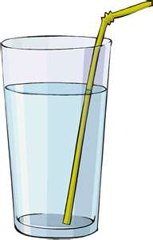

Test 2
Nightclub with a minimum legal drinking age of twenty-one. You are the bouncer.
4 patrons at the bar.
Rule=People under 21 cannot be served alcohol. Can ask people their age or check their drink but can’t do both.
Drink/Age: 1>Water 2>Over 21 3>Beer 4>Under 21
Notes:
Shermer-The Mind of the market:etc.
http://books.google.com/books?id=PKjfEOGNZWAC&printsec=frontcover&dq=compassionate+apes&source=bl&ots=uLSP0sKp57&sig=Xrvhi7jS_YhDet64e16r1GiDII8&hl=en&ei=D8r3TLxFi6CxA6qc4MgC&sa=X&oi=book_result&ct=result&resnum=4&ved=0CC8Q6AEwAw#v=snippet&q=drink&f=false

Slide 9
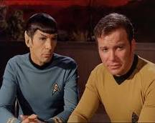
Almost everyone solves this problem.
Note-they are the same exact logic
We have evolved to quickly understand problem 2, problem 1 is learned (or not learned by 80%)
We should code with this idea in mind

Slide 10
Code EXAMPLE
public double GetClassAverage(List<int> listOfClassScores)
{
int totalOfScores = 0;
int numberOfTests = listOfClassScores.Count;
foreach (int score in listOfClassScores)
{
totalOfScores = totalOfScores + score;
}
double classAverage= totalOfScores / numberOfTests;
return classAverage;
}

Slide 11
Thinking in words Advantage
public double GetClassAverage(List<int> listOfClassScores)
{
int totalOfScores = 0;
int numberOfTests = listOfClassScores.Count;
if (numberOfTests == 0)
{
return 0 ;
//or
//throw new Exception("There are no scores in the class score list");
}
foreach (int score in listOfClassScores)
{
totalOfScores = totalOfScores + score;
}
double classAverage= totalOfScores / numberOfTests;
return classAverage;
}

Slide 12
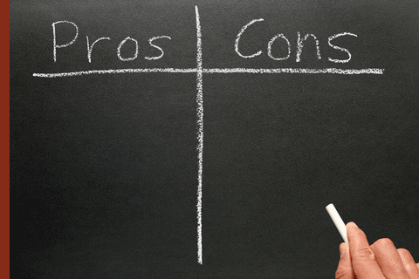
PROS AND CONS
PRO-Anyone can understand it just by reading it
CON-Not a generic answer so not as easily reused
However can derive from more generic answer

Slide 13
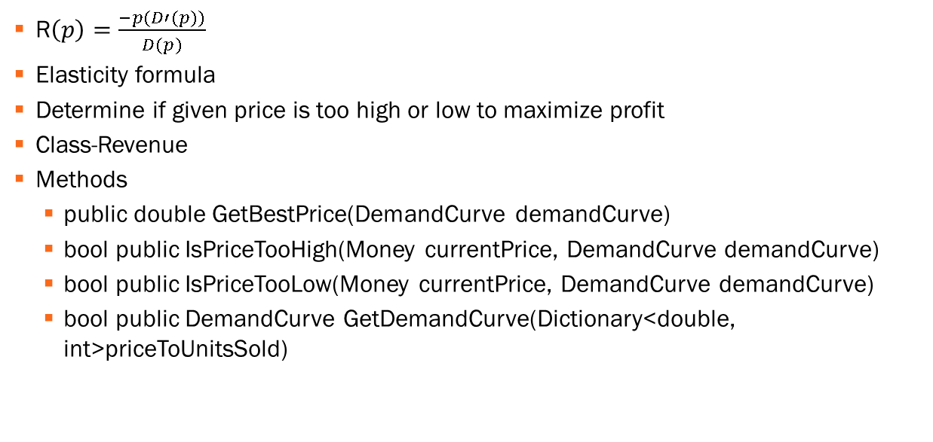
Mental Exercise
R$\left(p\right)=\frac{−p(D′(p))}{D(p)}$
Elasticity formula
Determine if given price is too high or low to maximize profit
Class-Revenue
Methods
public double GetBestPrice(DemandCurve demandCurve)
bool public IsPriceTooHigh(Money currentPrice, DemandCurve demandCurve)
bool public IsPriceTooLow(Money currentPrice, DemandCurve demandCurve)
bool public DemandCurve GetDemandCurve(Dictionary<double, int>priceToUnitsSold)

Slide 14
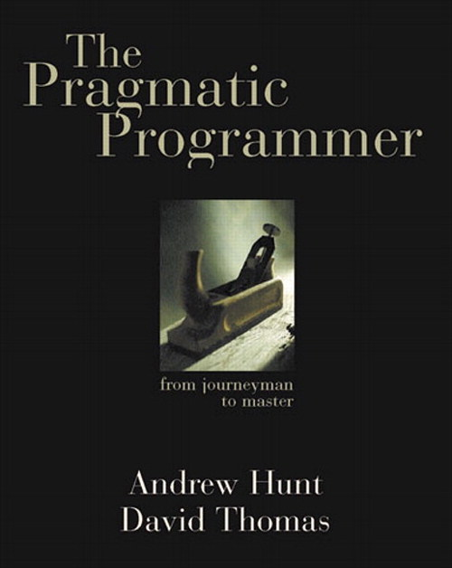
From pragmatic Programmer
If (state==TEXAS)
{
rate=TX_RATE;
amt=base * TX_RATE;
calc=2 * basis(amt) + extra(amt) * 1.05
}
else if ((state ==OHIO) || (state==MAINE)){
rate=(state==OHIO) ? OH_RATE : ME_RATE;
amt=base * rate
calc =2*basis(amt) + extra(amt) * 1.05;
if (state==OHIO)
points=2
}
else {
rate=1;
amt=base;
calc=2*basis(amt) + extra(amt) * 1.05
}

Slide 15

Looking AT PATTERNS
What is the same?
calc=2 * basis(amt) + extra(amt) * 1.05
amt=base * rate
What is different?
Rate by state
One special case for OHIO

Slide 16

Better Version
rate=rate_lookup[state]; //could be function or dictionary
amt=base * rate;
calc=2*basis(amt) + extra(amt) * 1.05
if (state==OHIO)
{
points=2;
}

Slide 17

Refactoring TRICKS in Visual Studio
Extract Method
Rename
Promote Variables
Extract Interface
Encapsulate
Reorder Parameters

Slide 18

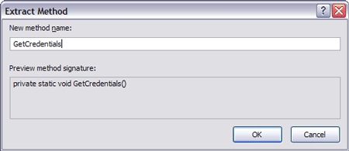
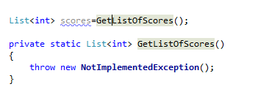
VISUAL STUDIO IS PSYCHIC
Type in a name of what you want to do and end with ()
For example, GetListOfScores()
Visual Studio prompts you to create a method

Slide 19

Why do this?
First write down the actions (methods) you are going to do
Maximizes readability
Also helps later for creating Unit tests

Slide 20

Let’s Try IT
Make a couple of functions
Note the not implemented exception

Slide 21
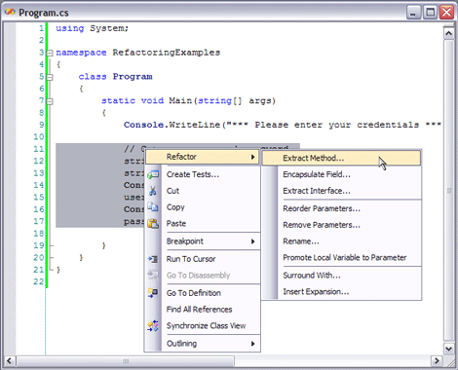
Extract METHOD
Highlight Code
Right Click→Refactor→Extract Method

Slide 22

WHY EXTRACT METHOD
Tell the User “What” you are doing so you don’t have to show them how you did it
Never write the same code twice

Slide 23

Let’s Try IT
int currentvalue=1;
bool isValidUser=false;
if (currentvalue==1)
{
return true;
}
//what are we doing, not how are we doing it
// if the currentvalue is 1 then user has access

Slide 24
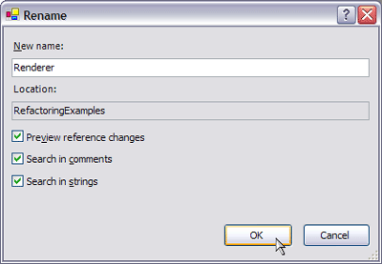
A ROSE BY ANOTHER NAME?
Rename a variable
Right-click on variable name
RightClick→Refactor→Rename Variable

Slide 25

WHY DO THIS?
Easiest way to comment your code is tell the user what it is doing
Never should have none obvious names for variables

Slide 26
Let’s Try IT
List<int> l=new List<int>();
l.Add(1);
l.Add(2);
//what happens when we change l

Slide 27
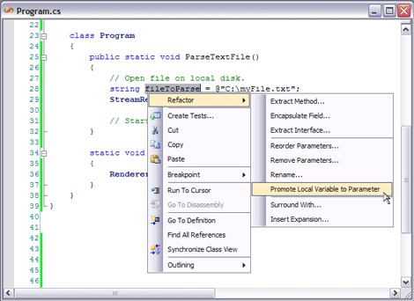
Your code just got A Promotion
Promote variables from inside the method to signature
Right-click→Refactor→Promote Local Variable To Parameter

Slide 28

WHY DO THIS?
Make method more generic and reuseable
Make it easy to unit test

Slide 29

Let’s Try it
Public void bool GetUserRights()
{
int i=0;
if (i ==0)
{return true;}
else
{return false;}
}
///let’s promote I and give it a more readable name

Slide 30
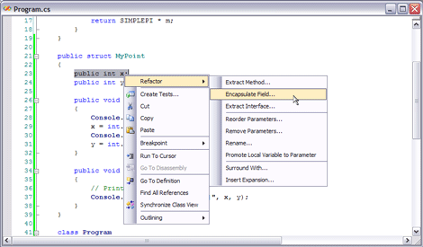
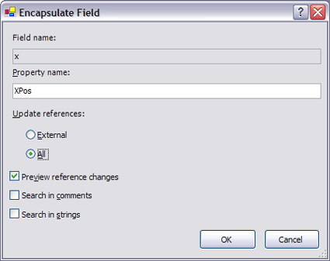
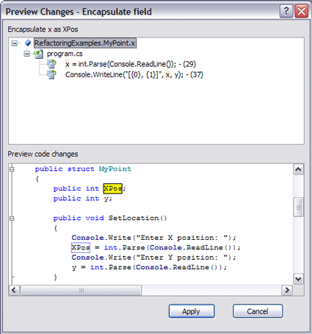
More ABOUT PROPERTies
Encapsulate fields
Highlight variable
Right Click→ Refactor→Encapsulate Field

Slide 31
END Result
private int x;
public int XPos
{
get { return x; }
set { x = value; }
}
public Statistics()
{
XPos = 3;
}

Slide 32
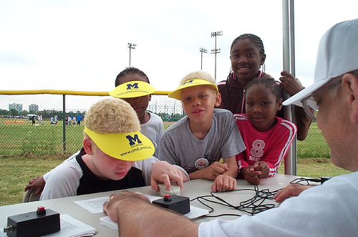
Let’s Try IT
Create a class with a value and use encapsulate

Slide 33
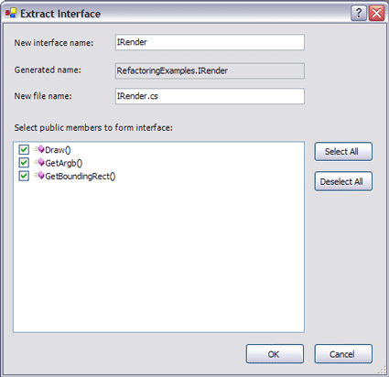
MAKE A CONTRACT
Use the extract interface
Right-Click→Refactor→Extract Interface

Slide 34

WHY DO THIS?
Make sure your class doesn’t break in the future
Allows you to create other more specific instances to generic formula
Talk about this more in SubSonic workshop

Slide 35
Let’s Try IT
Create a class called Point with 2 ints, getpoint method, setpoint method
Create an interface
Create a class that implements the point interface

Slide 36

WHY DO THIS?
Hide details from users
Good OOP Design
Good design is making good decisions so your users can’t make bad ones

Slide 37
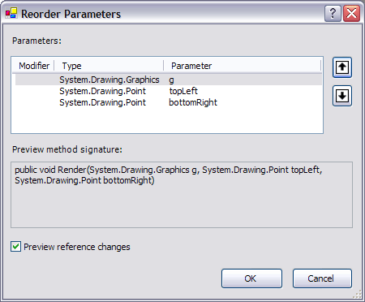
The ORDER of THINGS
Use the reorder parameters
Right Click→Refactor→Reorder Parameters

Slide 38
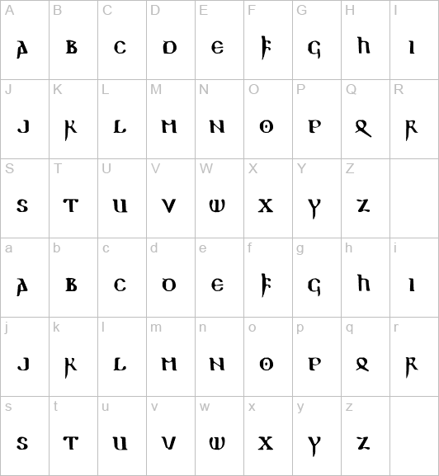
WHY DO THIS?
Maximize readability
Low on list- just nice

Slide 39

Let’s make some SQL
Create a table
Create a view with and without alias of fieldnames
Create 2 stored procs for each view

Slide 40
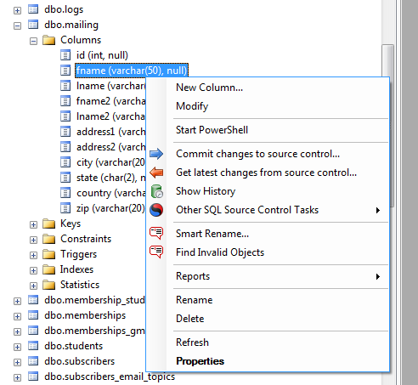
REFACTOR YOUR SQL WITH REDGATE
Right Click item→
Smart Rename…

Slide 41
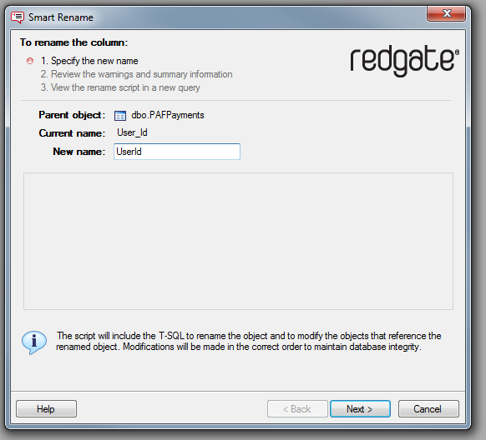

Slide 42
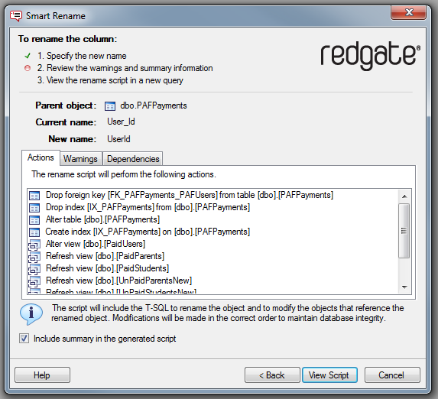

Slide 43
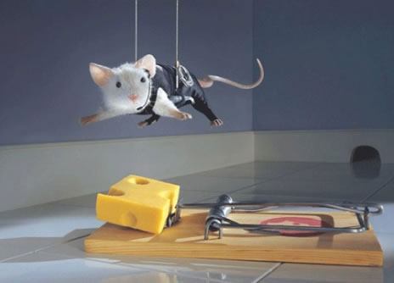
BETTER MOUSETRAP
Smart rename finds all references
Allows you to rename with confidence
Views and Functions in SQL are like Interfaces
Think what would have broke in code downhill

Slide 44
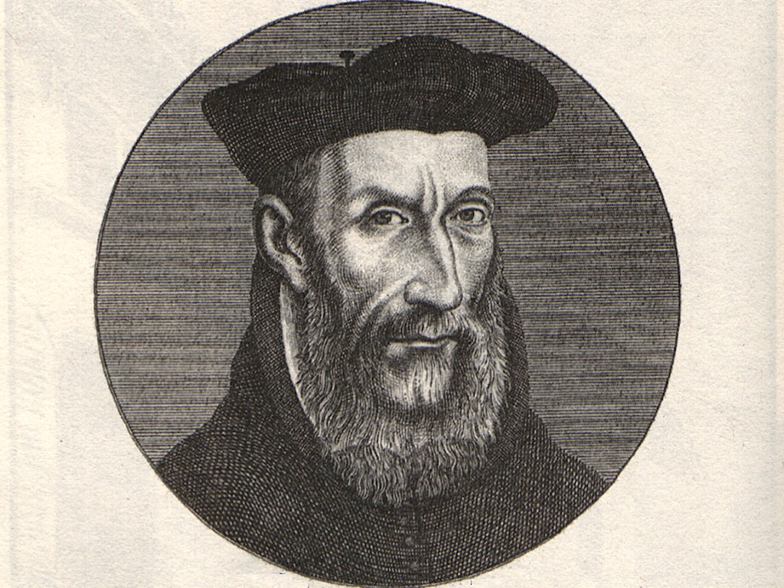
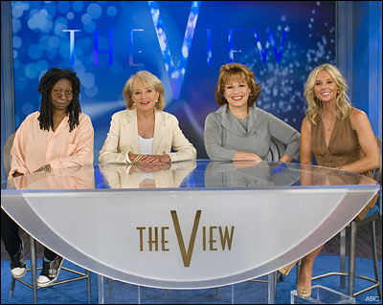
WHAT YOU VIEW IS WHAT YOU GET
Call views in stored procedures
Allows you to not have to worry about table structure changes
OLA_PS to new Online Application database transition was smooth
Gumby Bridge called tables-> not so great
Your job is to try and predict the future of your code

Slide 45

WHATS YOUR FUNCTION
Use SQL Functions to tell you what you are doing
Encapsulate details –USE GetProcessType(@Processid)
CASE processid
WHEN 0 THEN 'LIVE'
WHEN 1 THEN 'PENDING'
WHEN 2 THEN 'TOLOAD'
WHEN 3 THEN 'BADBOYZ'
ELSE 'UNKNOWN'
END

Slide 46
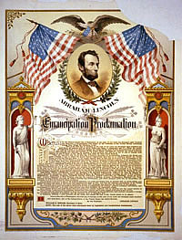
PROC-lomation
Code against the stored procedure not the tables
Allows you to encapsulate details
Show be GetUsersScholarships(@EMPLID)
Should not be (select * from scholarships where blah is true and emplid =22200090

Slide 47

THE TRINTITY
Data should be data
Logic should take in data and get results
Presentation should present the output of logic
Remote Control Example
Data-what channel you want, go up or down a channel
Logic-process signal information
Presentation -show result of signal information
You want one remote control that processes the result (logic) of what you want want(data) to show you what you want to see (presentation)

Slide 48
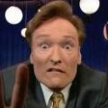
What DID WE LEARN TODAY
What is refactoring?
Why you always should be doing it
How you do it in Visual Studio
How you do it with RedGate and database design
http://msdn.microsoft.com/en-us/library/ms379618(v=vs.80).aspx

